Slide 1
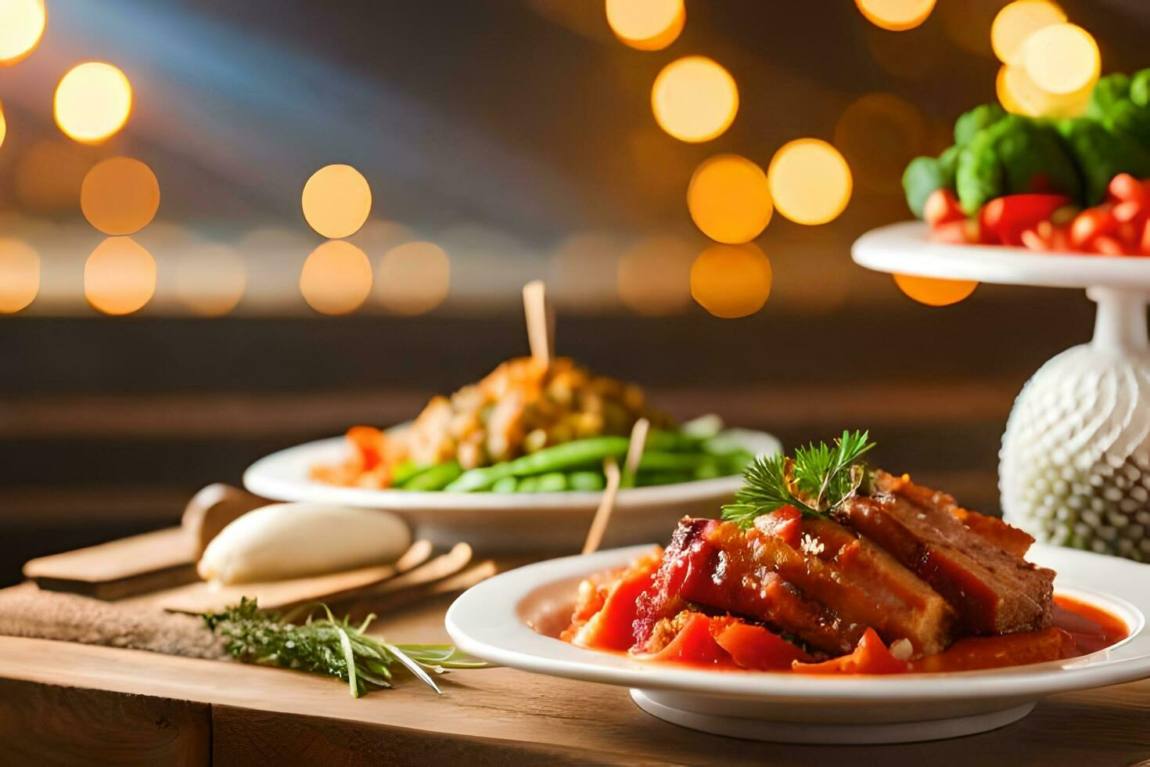
A Website Application Using
Java Spring
NEU, CS 5004, Prof. Mark Miller
Presented by
Liuyi Yang,
Xiaofeng Zhao,
Junhui Su
Notes:
30秒 Yang
我是xxx他是xxx他是xxx
Our topic is about building a website using java spring framework. By the end of our presentation, you should know how our website looks like, and how we implement it
我们的项目是使用java spring构建的一个网页，通过我们的presentation，你可以了解到我们的网站有哪些功能，以及我们是如何实现这样一个网站到线上的

Slide 2
onkitchen.online
Notes:
30秒
Zhao
Here’s our website link, you can see that our site is about cooking. Most of us are international students, and many of us have cooked for ourselves. Since we need to cook, we must buy ingredients. This is where a problem arises.

Slide 3
04
01
Missing Some Items
What To Buy?
02
05
Where To Buy?
Not Enough
06
03
How Many To Buy?
Too Much
onkitchen.online
Notes:
Su(1min
// have you ever cook on yourself?
have you ever run into the problem concerning about ingredients?
For example, we want to make a mapo tofu tonight, and we head to some supermarket.
Maybe you know that we need tofu, some minced pork, but, how many pounds of them?
what else, like, what kind of sauce do we need?
And what if, we bought too much and had to throw them away after they went bad

Slide 4





Maybe This Website is The Solution.
onkitchen.online
Back-End
Front-End
Database
Hosting Service
onkitchen.online
Notes:
1.5分钟
Liuyi
Here’s the link
Our website has 3 pages mainly. Demonstrating each page…@zhao 你想不想带大家浏览三个页面？ 想的话可以你来！ ( 都行，我想你来，因为我讲的有点多了
页面可以加菜、得到购物清单
网站和后端以及数据库是联通的，换个设备数据也都在
Our website is dynamic, which means if you modify some values, and refresh, it will keep.

Slide 5
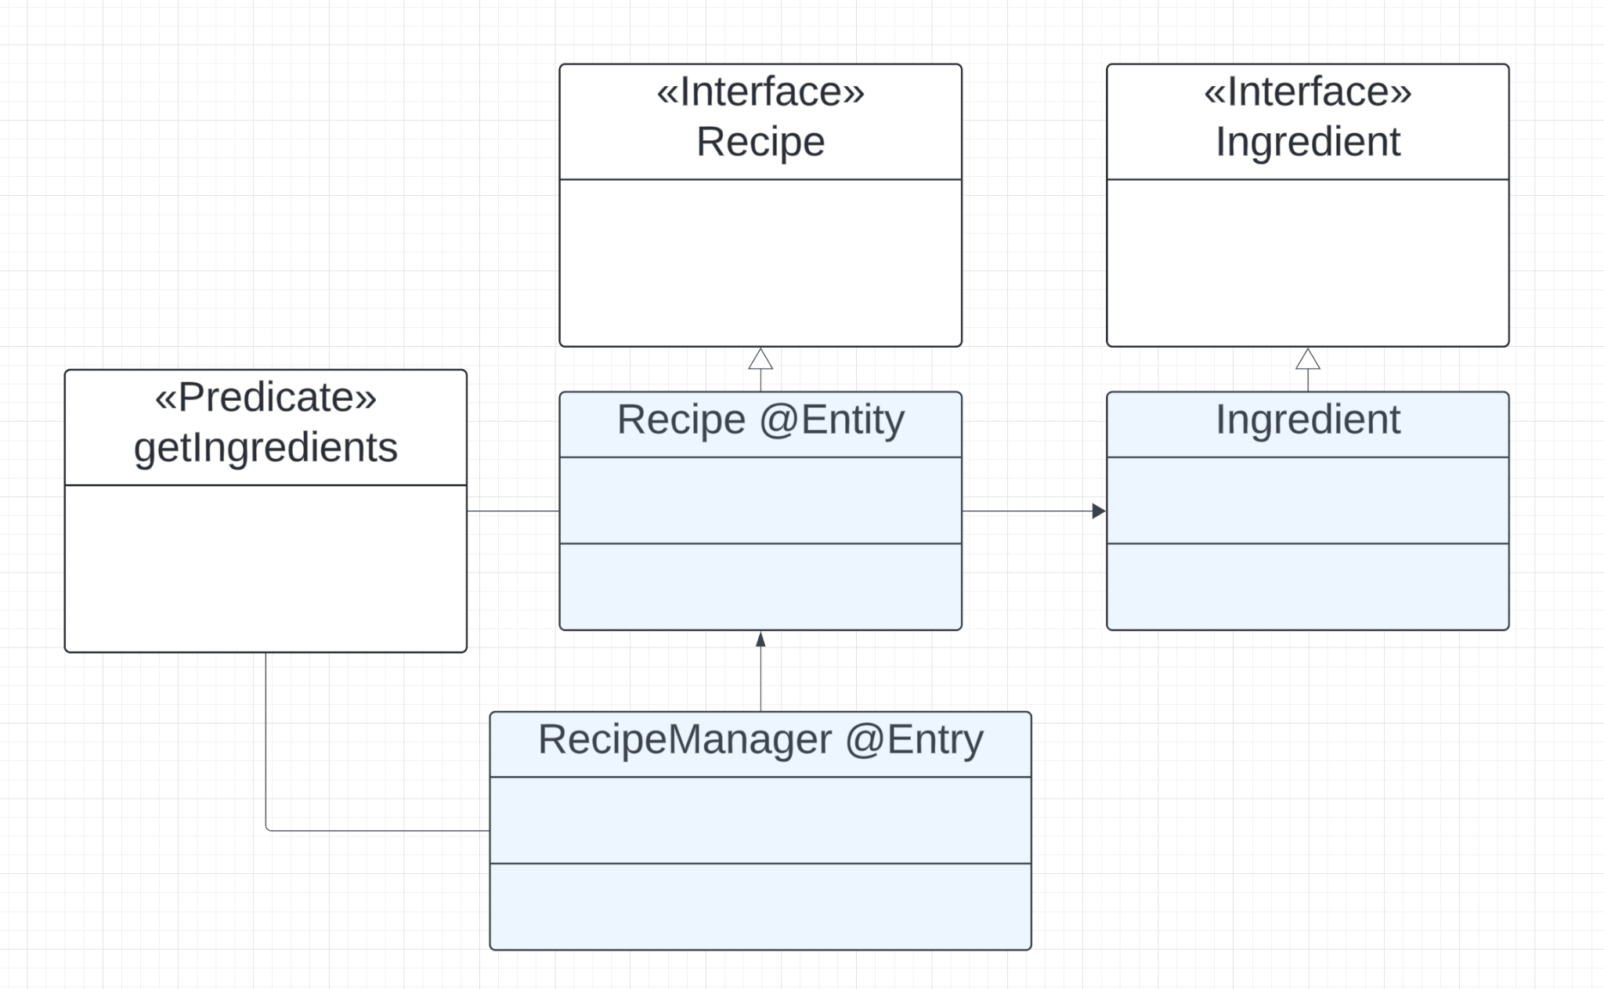
UML OOD Design
&& Encapsulation
UML Design
Followed The Best Practice.
API Encapsulation
The Whole Back End is encapsulated in the API.
onkitchen.online
Notes:
30秒
Zhao
As shown in the diagram above, this is the UML structure of our program. We've implemented two specific classes, each connected to its corresponding interface. Additionally, we've utilized a predicate to retrieve specific data from the database. To streamline our work, we've encapsulated the entire backend into a single API

Slide 6
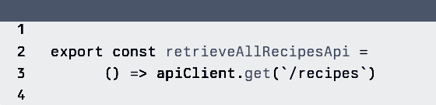
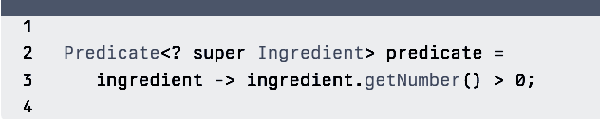
UML OOD Design
&& Encapsulation
UML Design
Followed The Best Practice.
API Encapsulation
The Whole Back End is encapsulated in the API.
onkitchen.online
Notes:
30秒
Zhao

Slide 7
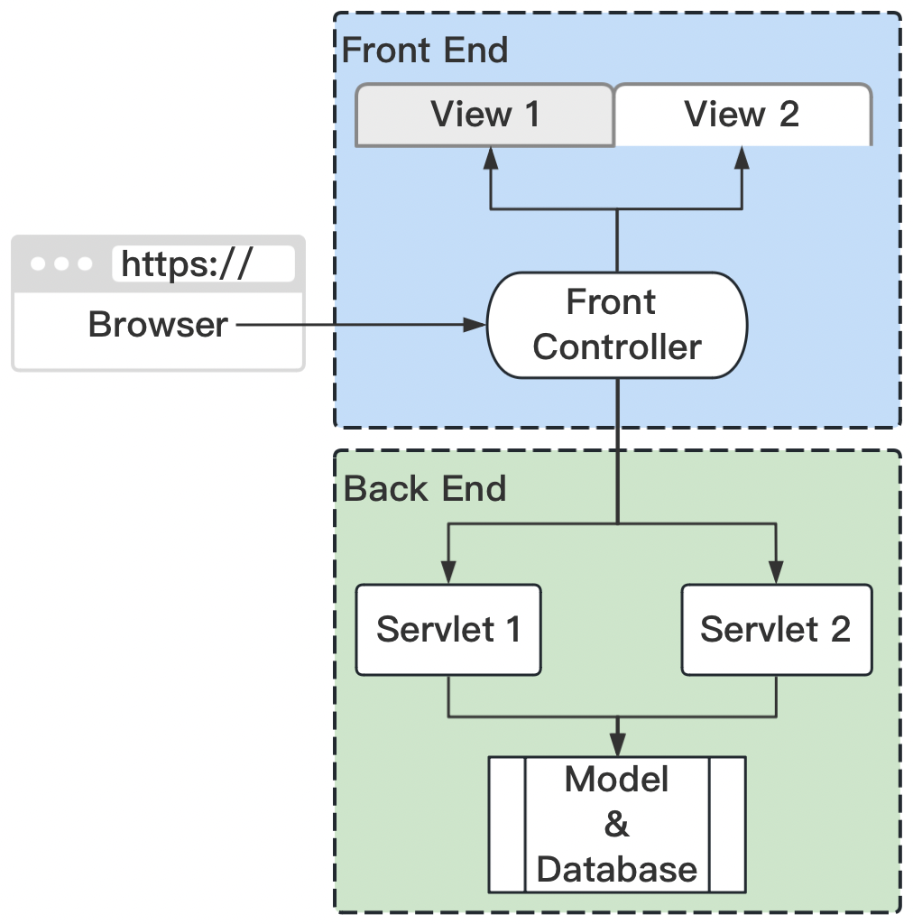

MVC Model 2
Architecture
Central FrontController
Distributed BackEndController
onkitchen.online
Notes:
Zhao || Su（1-1.5min）
our project is mainly in an MVC Model 2
which is a little different from what we have learned MVC model in that
the front-end controller talks to multiple back-end servlets and multiple front-end views;
these servlets read data and methods from the back-end model and our database
passing information through the front controller to update the view

Slide 8

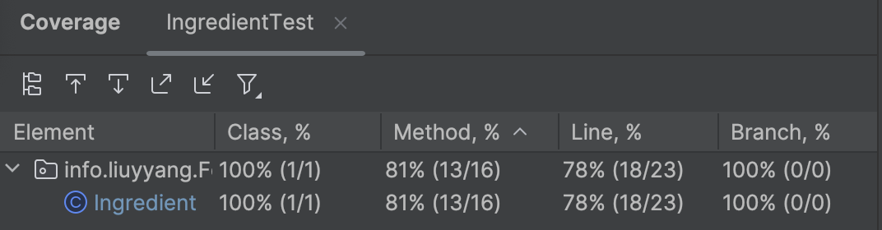
Unit and Mock Test
Using Junit
80%+
Statement Coverage
for the back end
onkitchen.online
Notes:
Su 30s

Slide 9
Key Takeaways
Current Limitations && Future Extensions
Using Java Spring as the backend
Full-stack web development experience
Collaborating in an unfamiliar project
Notes:
Su

Slide 10
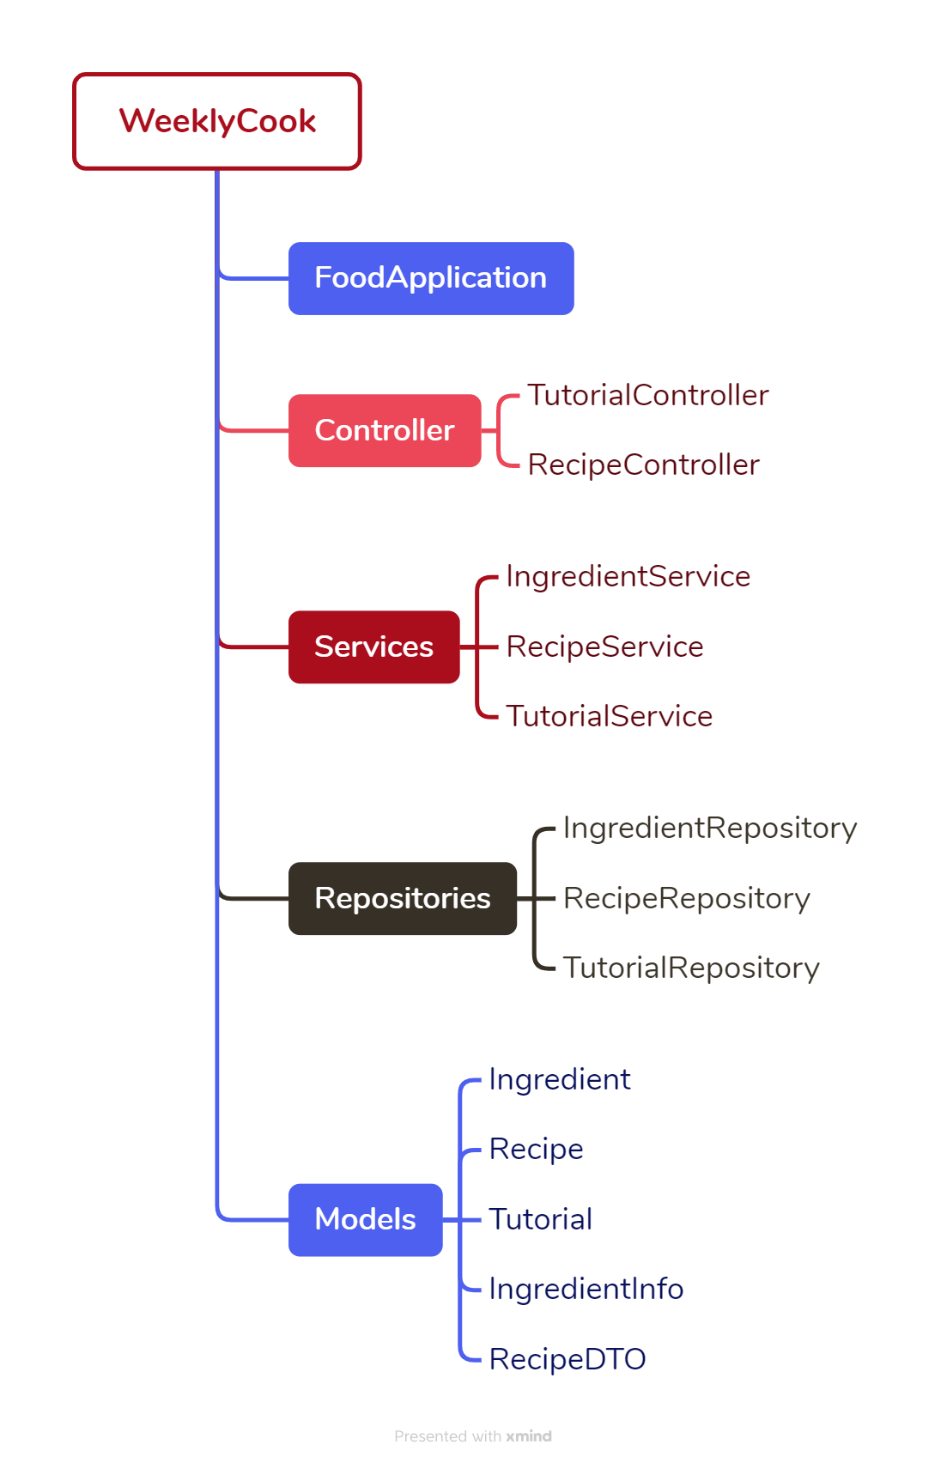
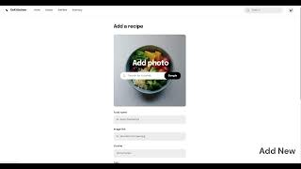
What’s Our Next？
Current Limitations
Too Basic
Future Extensions
Beauty UI; Authentication; Store API
Version 2.0 Demo
Liuyi
Notes:
1.5 to 2分钟 Liuyi 作为一个常年在减脂瘦身的人，想要吃得好还是得自己做饭。我身边的朋友也有很多这个需求。我个人甚至花了30多块钱买过别的APP会员，但功能太花哨、更关注于锻炼、自带的太难吃，所以一直没有合适的app。
我是真需要这个APP，所以在team的基本任务完成后，所以决定干脆自己做一个核心功能齐全的升级版极简APP。
新版本的文件结构是xxxxx有xxxx功能

Slide 11
Back End
Front End
https://t.ly/84YcW
https://t.ly/j5Uwt
for version 1
Notes:
freeCodeCamp.org. (2023, January 19). Full Stack Development with Java Spring Boot, React, and MongoDB – Full Course [Video].
YouTube. https://www.youtube.com/watch?v=5PdEmeopJVQ

Slide 12
这个小人我已经融合到下一页了，如果不需要这一页的话可以把这一页安全删掉！ （要留着的话也没事，跟我说一声我可以秒改回来）
Delete
onkitchen.online
Notes:
Yang 作为一个常年在减脂瘦身的人，想要吃得好还是得自己做饭。我身边的朋友也有很多这个需求。我个人甚至花了30多块钱买过别的APP会员，但功能太花哨、更关注于锻炼、自带的太难吃，所以一直没有合适的app，所以决定干脆自己做一个核心功能齐全的极简APP。 下一页：当我们自己做饭买菜的时候，我们有各种问题。。。。。

